Slide 1


KANGAROO
August 20, 2024

Slide 2


Slide 3

TIME to AGREE or DISAGREE
The next slide and statements will come up onto the screen.
As I read them out loud think if you agree or disagree with each statement.

Slide 4
Agree or Disagree?
Some students are unorganized.
Some students work outside of school.
Some students are not completing assignments.
Some students have activities before and/or after school
Some students fail classes.
Some students are not successful on assessments.
Some students babysit siblings after school.
Some students have to ride the bus and can’t stay after school.

Slide 5

Purpose of Power hour
Provide students time and access to:
Academics: teacher tutoring, study groups, peer tutoring, re-take exams, make-up assignments.
Social and Emotional Learning and Wellness: Communities in School, quiet room, art open studio, advisory lessons.
Enrichment Activities: club meetings, student planned activities, guest speakers, activities/events, open court
All of this during the school day!

Slide 6
Structure of Power hour
Power Hour begins immediately after the end of 4th period.
The time is divided into two 34 minute blocks—
Session A and Session B
  There are bells signaling for start and end times of each block
The Power Hour schedule is built based on what tutoring, clubs, organizations, and activities are offered. For example:
  Tutoring available multiple times a week
  One day a week is designated to have advisory, for us typically Monday
  Certain days may be utilized for clubs/organizational meetings, specified interventions, or tutoring.

Slide 7

What can students do during power hour?
Eat lunch during either A-Session or B-Session
Attend tutoring with a teacher
Make up missing assignments
Hang out in a teacher’s room
Participate in a club or an organization
Meet with college/career/military reps
Study in a classroom

Slide 8
STUDENT RESPONSIBILITIES DURING POWER HOUR
  During Power Hour, students would need to:
  DO SOMETHING DAILY
  Go to tutoring when you need help
  Take advantage of opportunities to get help with assignments
  Find a club or activity to participate in
  EARN HERO POINTS DAILY

Slide 9
STUDENT RESPONSIBILITIES DURING POWER HOUR
  During Power Hour, students would need to:
  Eat Lunch
  Clean up after themselves
  Throw away trash and clean tables
  Don’t Roam Halls
  Stay in one spot

Slide 10
Make your plan for success
Power Hour Schedules are posted around the building and projected in classrooms
Wednesday’s Advisory will also introduce an online schedule for Roos to look at any time.
Teachers have the schedules too
Make sure you attend something each day
Set a routine for the week. Focus on classes where you need the most help.
Choose something…
go there and stay for 30 minutes
DON’T ROAM HALLS

Slide 11


Expectation
During Power Hour
Every student will
  - Attend an activity or Tutorial Session
  - Eat Lunch
Notes:
Every day you will make sure that two things happen during lunch
You need to Attend a Tutorial Session for a subject you need help in and you need to Eat Lunch.

Slide 12
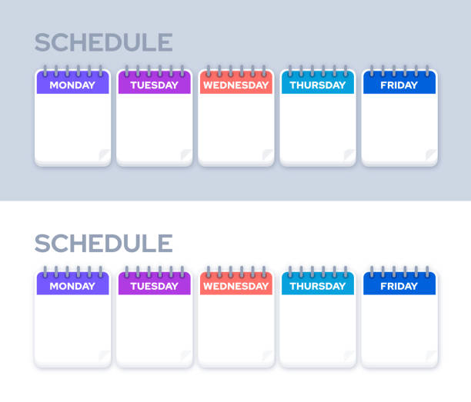

What Happens if…
I need to go to Biology and Algebra tutoring for help?
You have 4 tutoring sessions per week to attend. Choose your attendance wisely using the schedule.
ADVISORY
Notes:
What Happens if … I need help in Biology and Algebra in tutorials? What do I do.
(Click)
Purple Answer box
(click)

Slide 13

Gain Points Daily for Attendance
To Power Hour Events/Tutorials
Simple Authentication
Notes:
Hi! Welcome to Hero! I’m going to walk you through the steps of creating your student Hero account!

Slide 14

Power Hour participation is tracked in HERO. Everyday teachers will scan/enter students into HERO for POWER HOUR ATTENDANCE.
Points add up all year long!

Slide 15
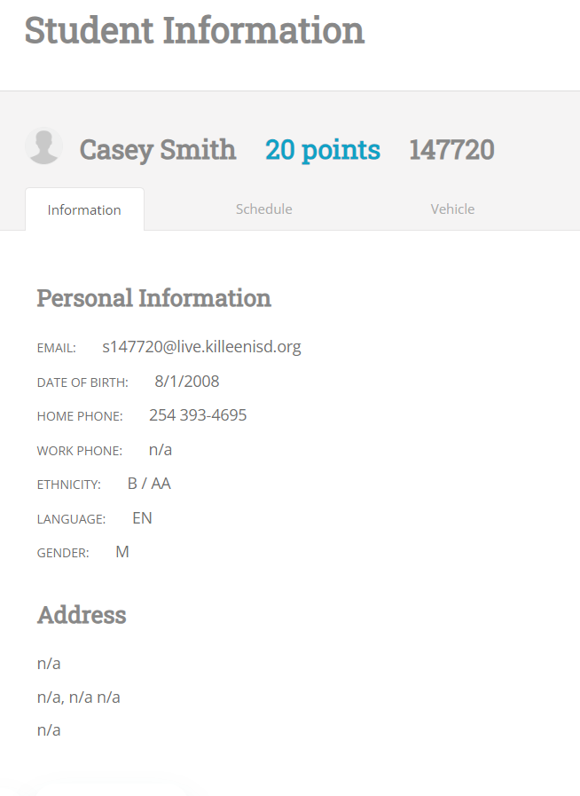
Advisory Teachers can show you points in hero
Any teacher can show you your Account points
Any Administrator can too
More info about accessing your account in coming weeks
Roo Student

Slide 16
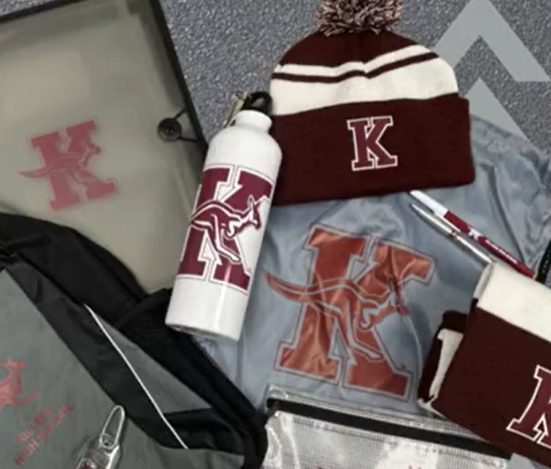
KHS SWAG STORE re-OPENS SOON!!

Slide 17

HERO POINTS
Use Hero Points to buy KHS Swag.
Extra Points awarded at school events- Just ask any administrator on duty at the game or event.
Attendance at a Power Hour Session is the campus expectation.
GET POINTS- GET REWARDS

Slide 18
Power Hour is a privilege. It can be lost if students abuse it.
Power Hour can help students improve their grades and can help close achievement gaps.
Gain Points Daily and Points can get you access to Spring Sporting events and cashed in for cool KHS Swag.

Slide 19
It is the expectation that all students attend a Power Hour session Daily
Get credit in HERO from teacher at session you attend
Administrators have already begun tracking Advisory Attendance since the first day.

Slide 20


ON THE ROAD TO

Slide 21
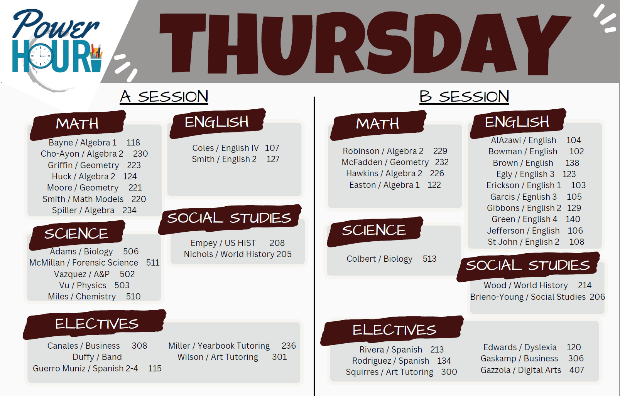

Slide 22
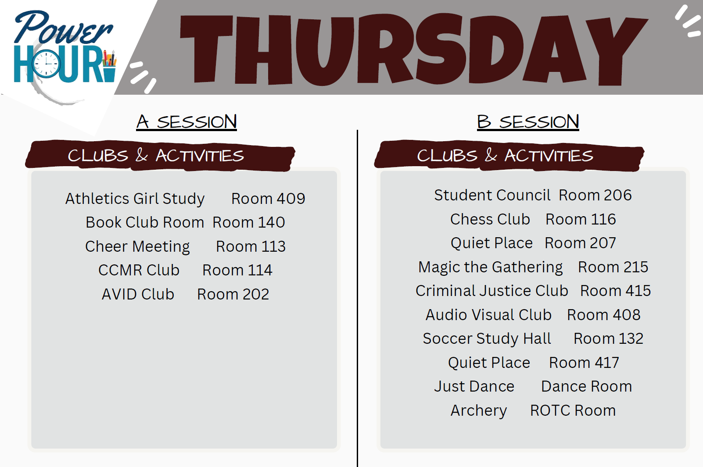

Slide 23

Start Planning today!
Where will you go on Thursday?
Already behind in a subject?
Need to redo and assignment
Have an activity you want to join?

Slide 24


Slide 25
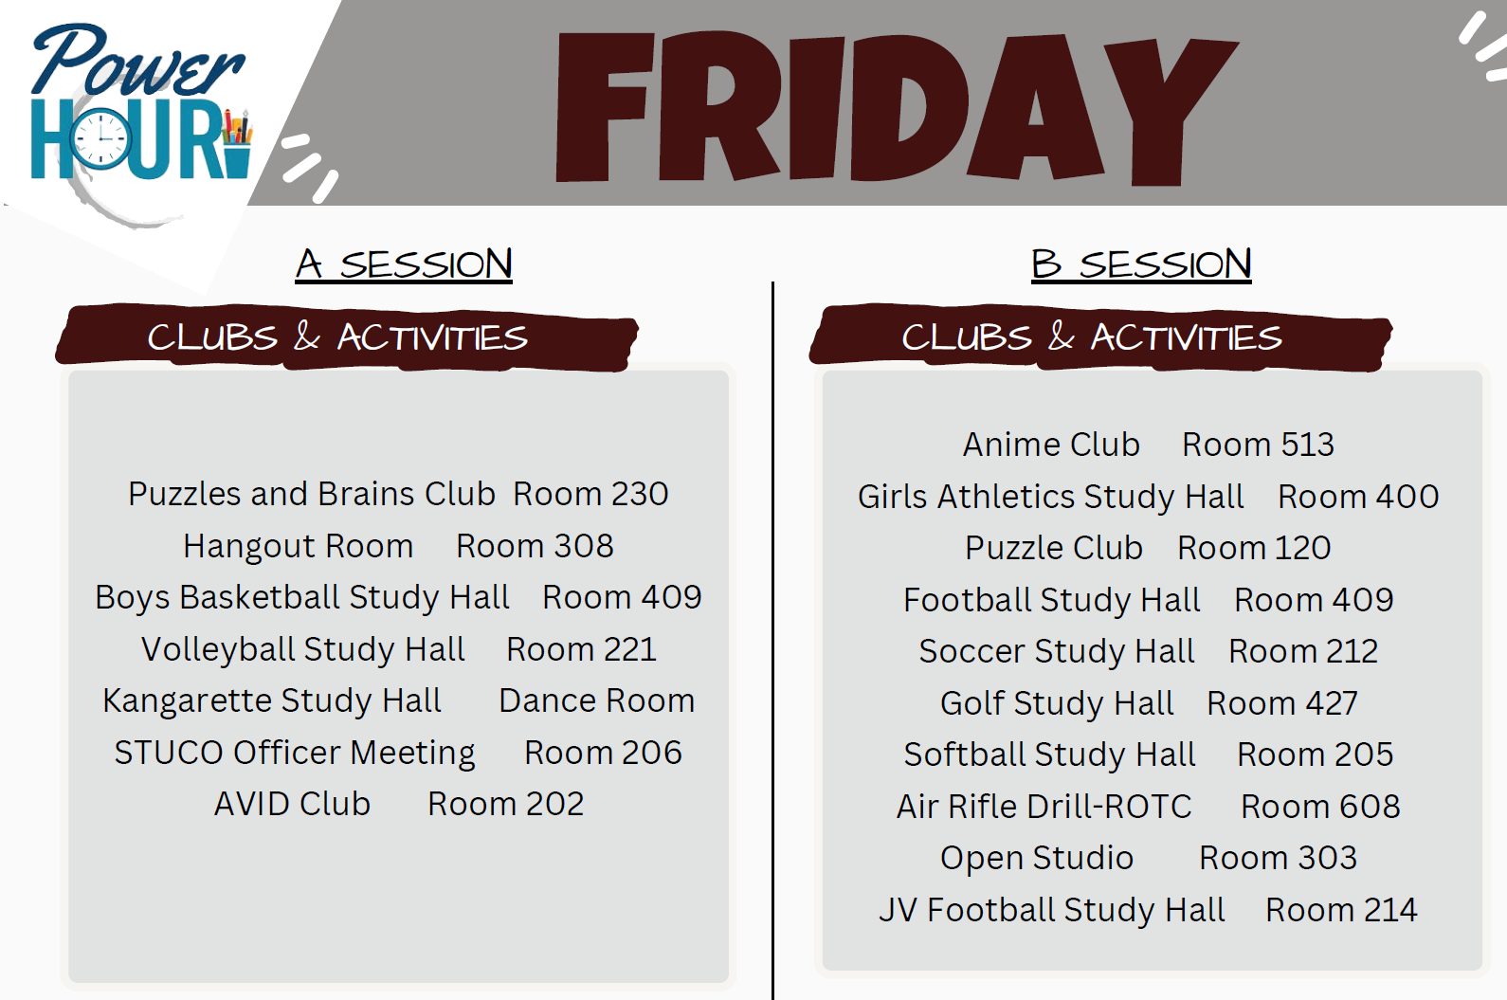

Slide 26

How will you utilize
Power Hour?

Slide 29

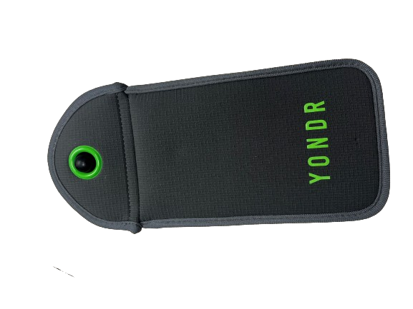
Yondr Pouches
Killeen High School
Killeen Independent School District

Slide 30
Pouches will be issued
WEDNESDAY in English
Classes

Slide 31
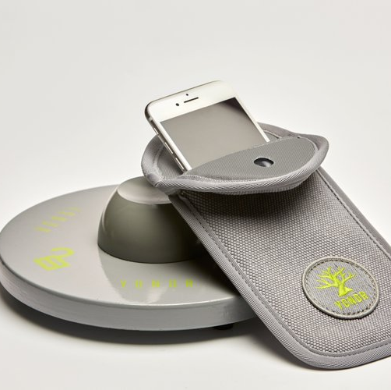
Expectations
Cellphone, Airpods/Ear buds, and smart watch will be turned off and must be put into the Yondr Pouch
When entering the building, you will lock your items up and place your pouch in your backpack or your person.

Slide 32
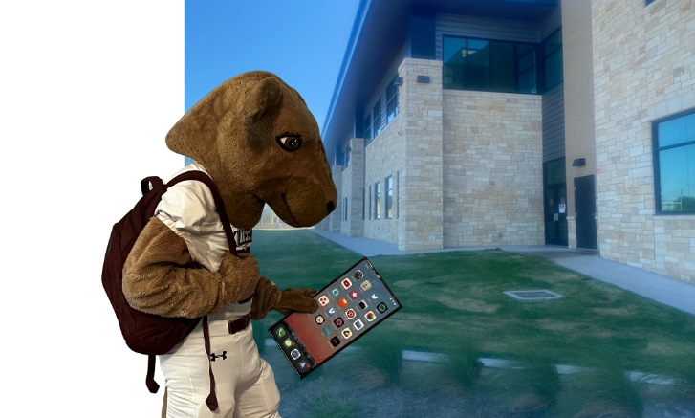
Everyday when you arrive…

Slide 33
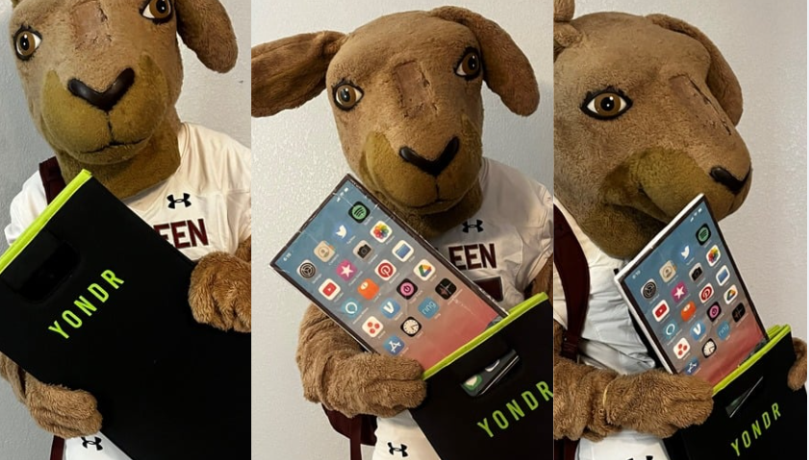
PUT YOUR ELECTRONICS IN THE YONDR POUCH!

Slide 34
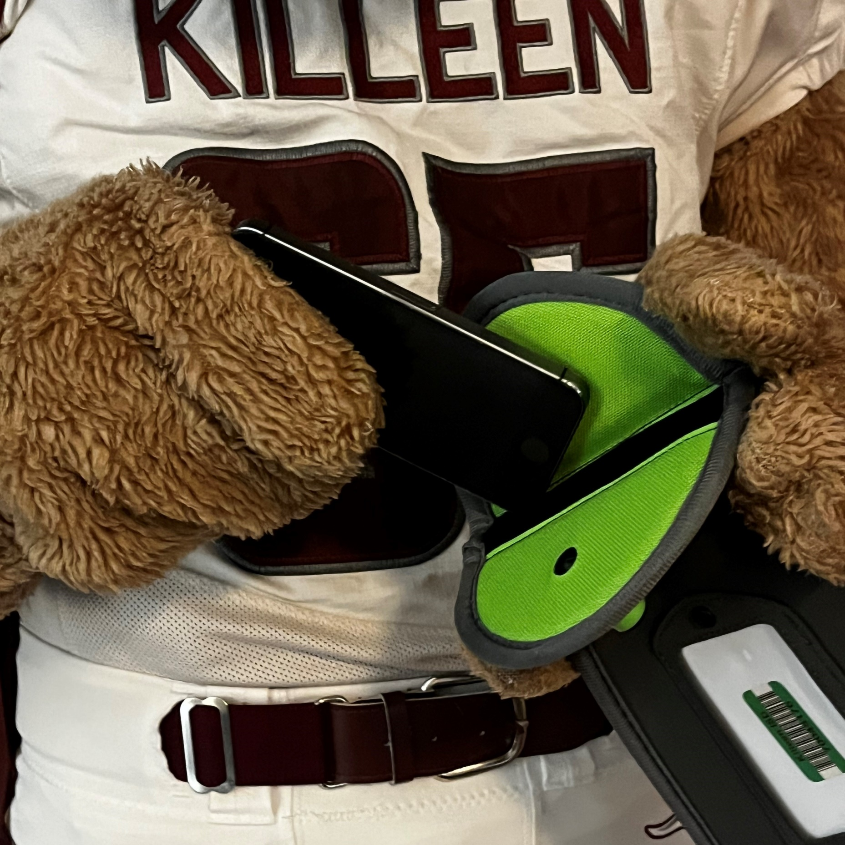
Turn devices off
SAVE YOUR BATTERY!
Power down the device before putting into pouch.

Slide 35
Put in Pouch
Cellphone, Airpods/Ear buds, and smart watch will be turned off and must be put into the Yondr Pouch

Slide 36
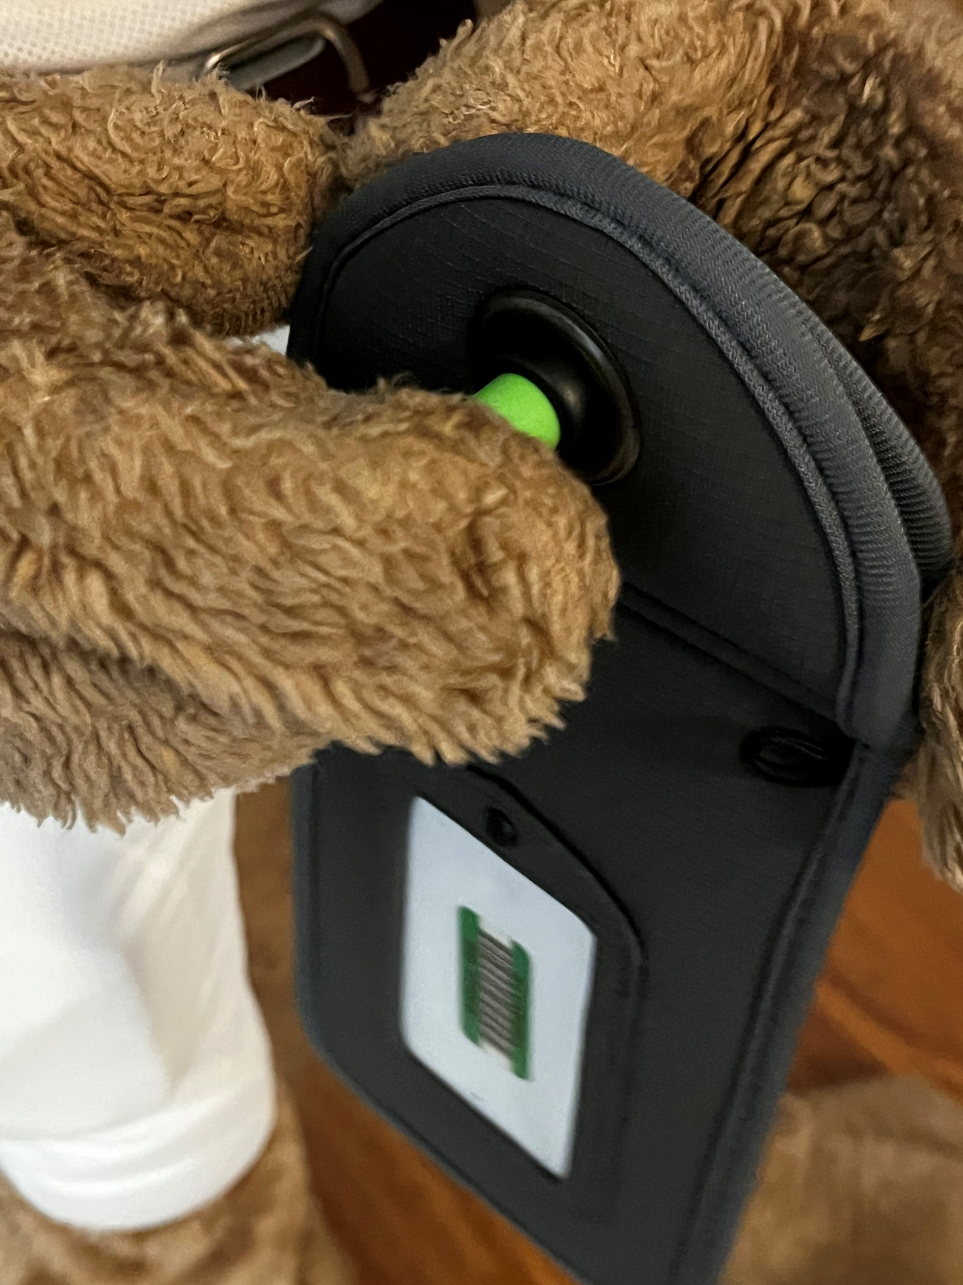
Green Button
If visible the pouch is unlocked

Slide 37
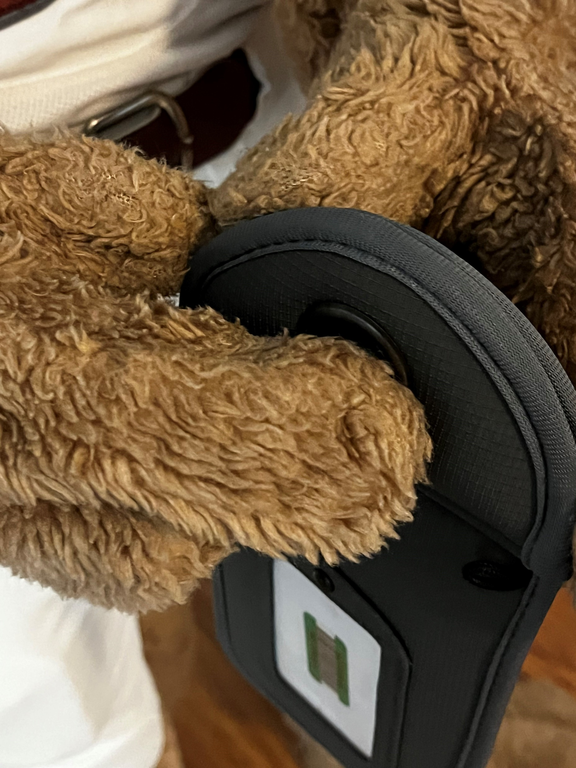
Secure your device
Push the button down to LOCK the pouch

Slide 38
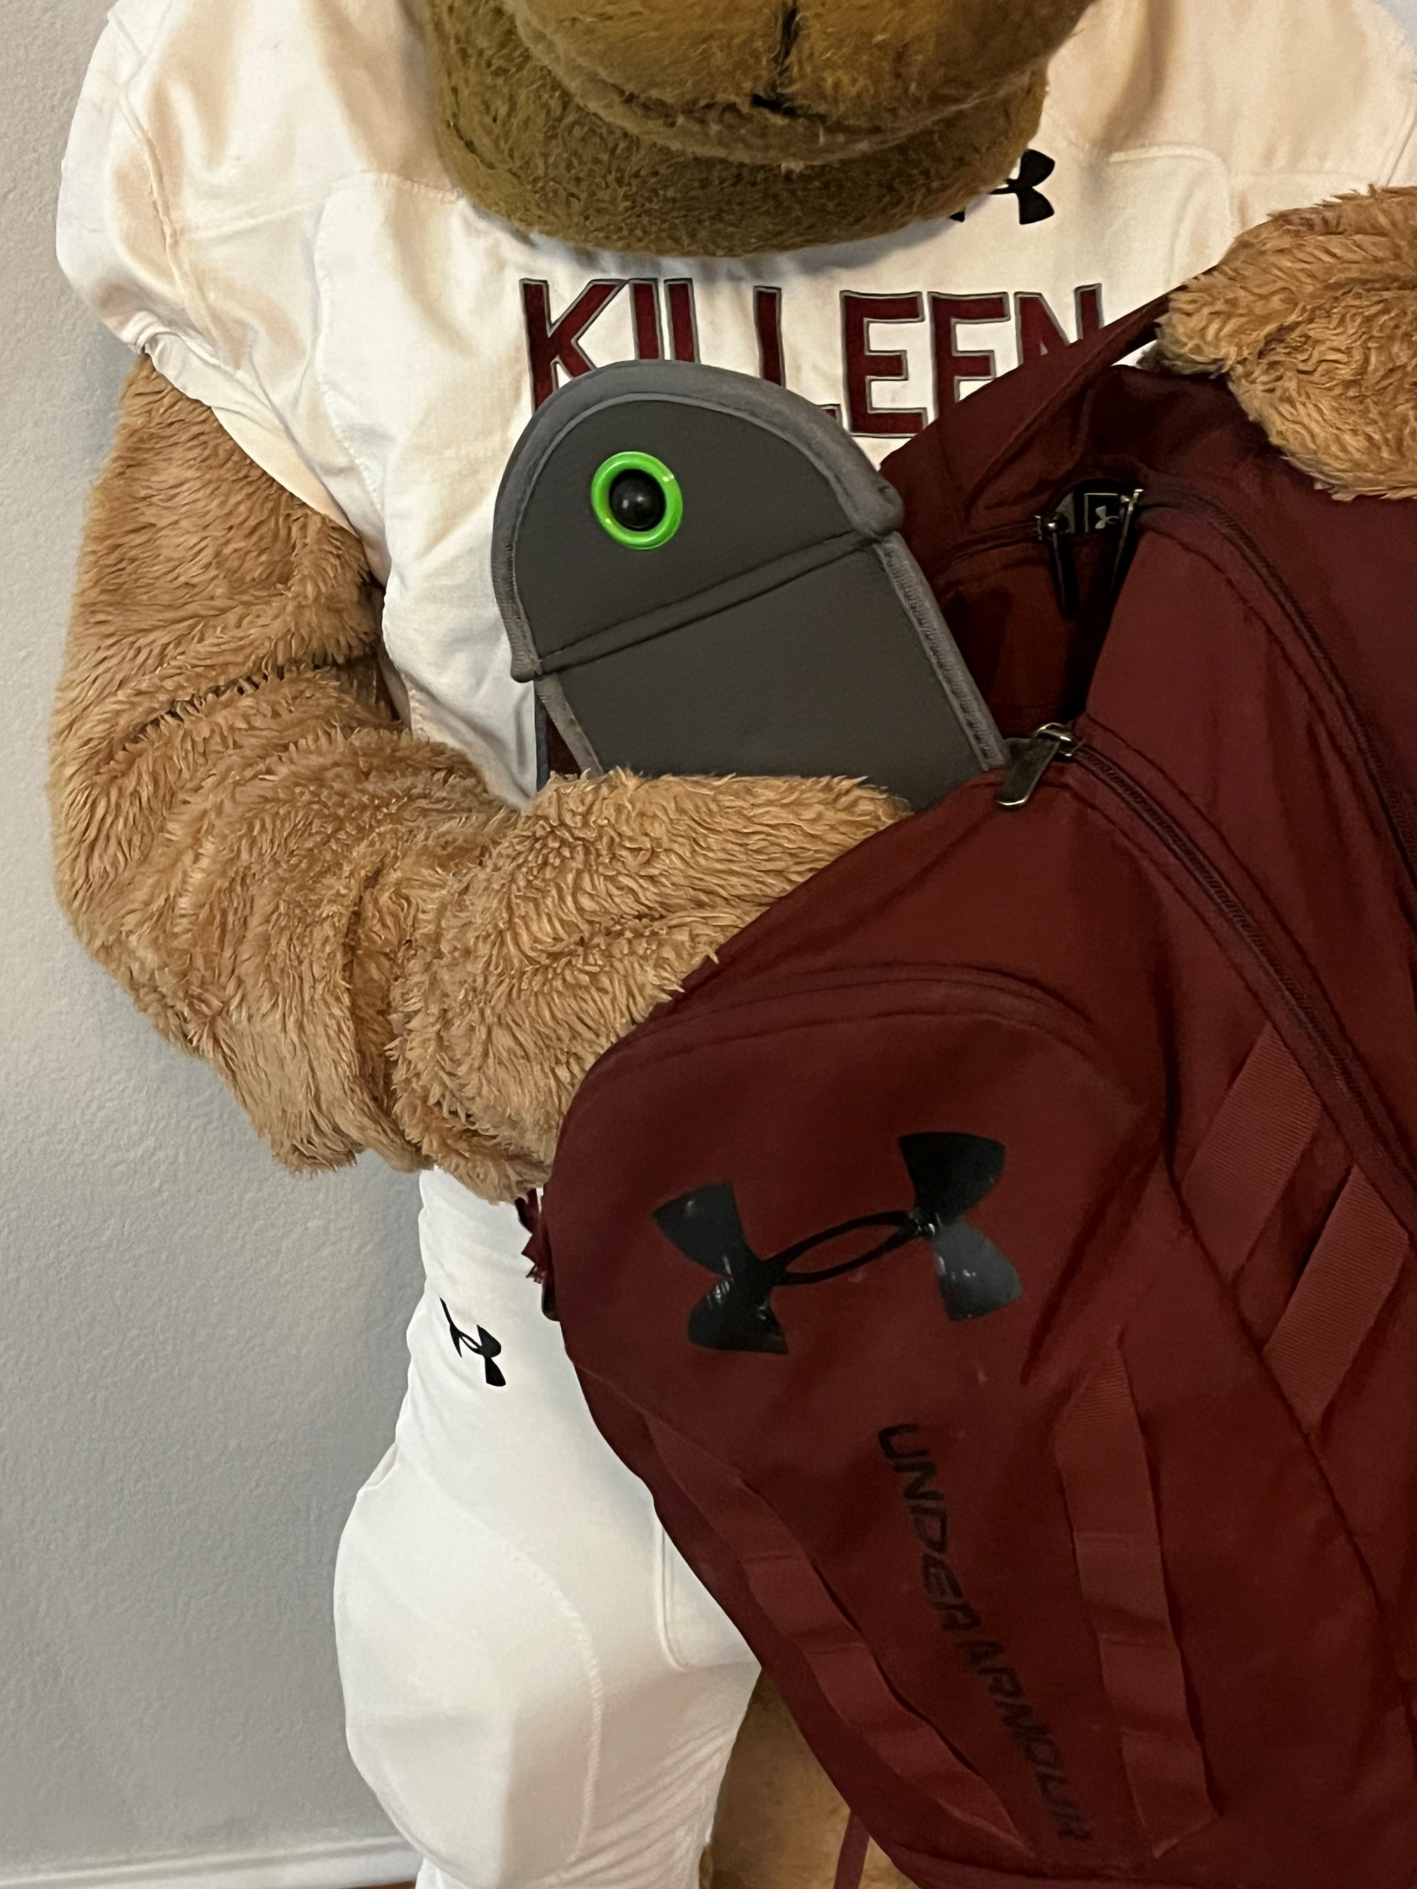
KEEP THE POUCH
Roos will keep their devices locked in pouches all day. You are responsible for your Yondr Pouch.

Slide 39
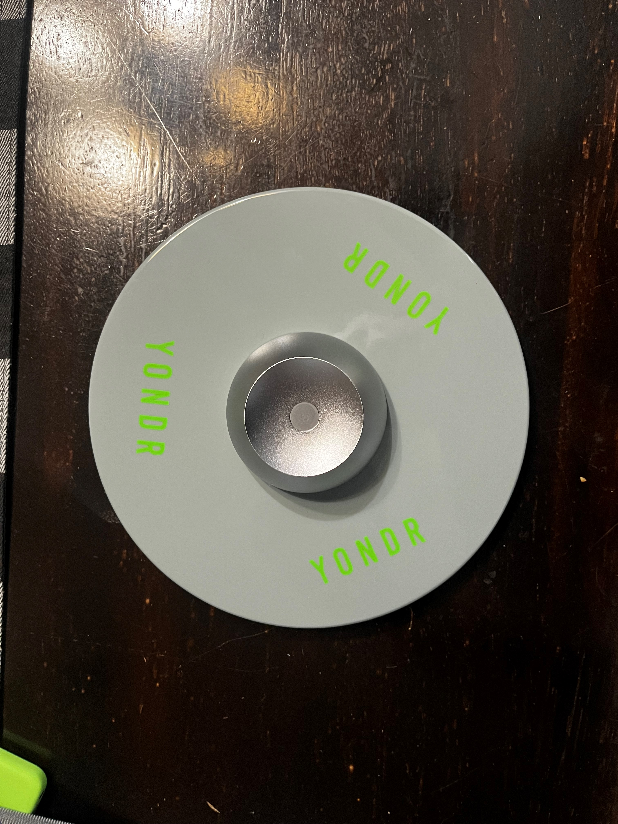
Unlocking at Dismissal
End of the day, there will be unlocking stations placed in the building in different exits
Have your pouch ready as your approach the unlocking station
When unlocking, place the rounded side into the magnet and press the button
Once unlocked, continue out of the building – do not congregate around the unlocking stations

Slide 40
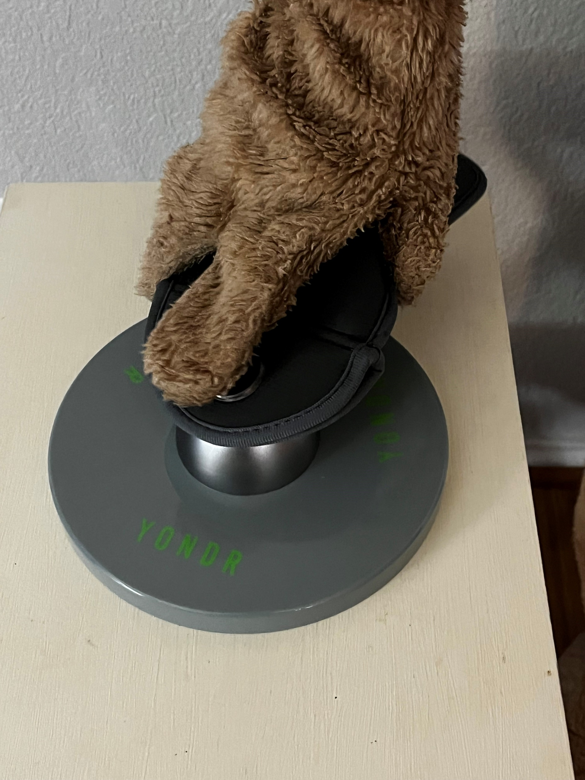
Place Pouch on Circle
Press the button to UNLOCK
Exit the building

Slide 41
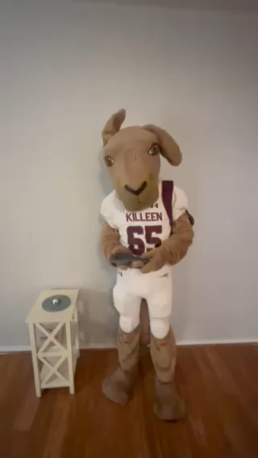
Unlocking is Quick and Easy
If video doesn’t play…
click mouse 1 time to play Kanga’s Video!

Slide 42
Other Situations
When being signed out for the day – you will be able to unlock in the front office once you have signed out
When signing in, you must show the front office your pouch, with items, locked before getting released into the building.
Career Center PM students will have their pouch unlocked when leaving campus but must lock it when arriving at KCC
  Career Center AM will lock theirs when they return to Killeen

Slide 43
Disciplinary Actions 1st – 3rd Violations
1st, 2nd, 3rd violations
Any unauthorized usage of cellphones will result in the following actions
Cellphone will be confiscated and stored in the AP office – student can pick up at end of the day and referral
Confiscation, parent/guardian contacted – parent/guardian must pick up phone during school hours, referral and lunch/after school detention.
Same as number 2, includes Saturday School consequence.

Slide 44
Disciplinary Actions 4th-6th Violations
4th, 5th, and 6th violations
Any unauthorized usage of cellphones will result in the following actions
Confiscation, parent/guardian contacted, in person conference with parent/guardian and administration, SERIOUS referral, 1 day ISS
Same as 4, but 2 days ISS and campus probation 45 days.
Same as 4, but 3 days ISS, Campus Level Conference with recommendation for placement at Gateway

Slide 45
A Yondr Pouch is like a textbook
Infractions also extend to:
  Damaging the Yondr Pouch in any way, shape, or form.
  Damage to the pouch to bypass the locking mechanism.
  Persistent loss or forgetting to bring pouch
  Damaging/stealing other’s pouch
If pouch is damaged or lost, student/parent/guardian will be responsible for the full cost of the pouch.

Slide 46
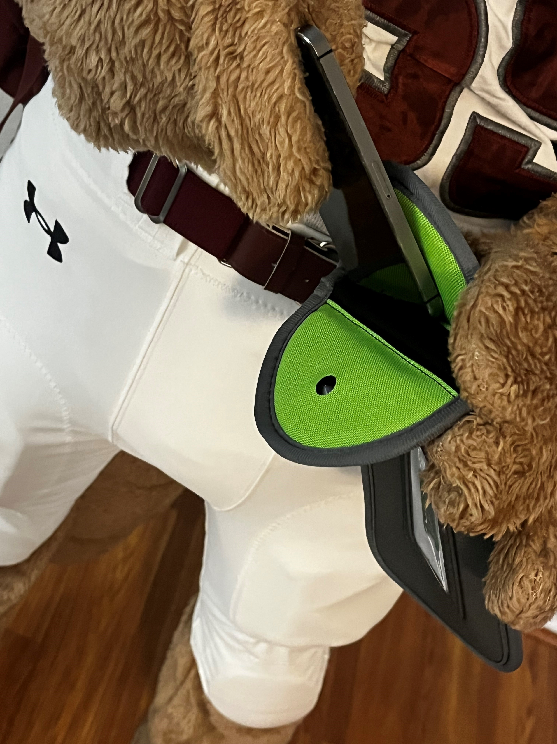
Keep it in the Pouch!
It is that simple!

Slide 47


